Slide 1
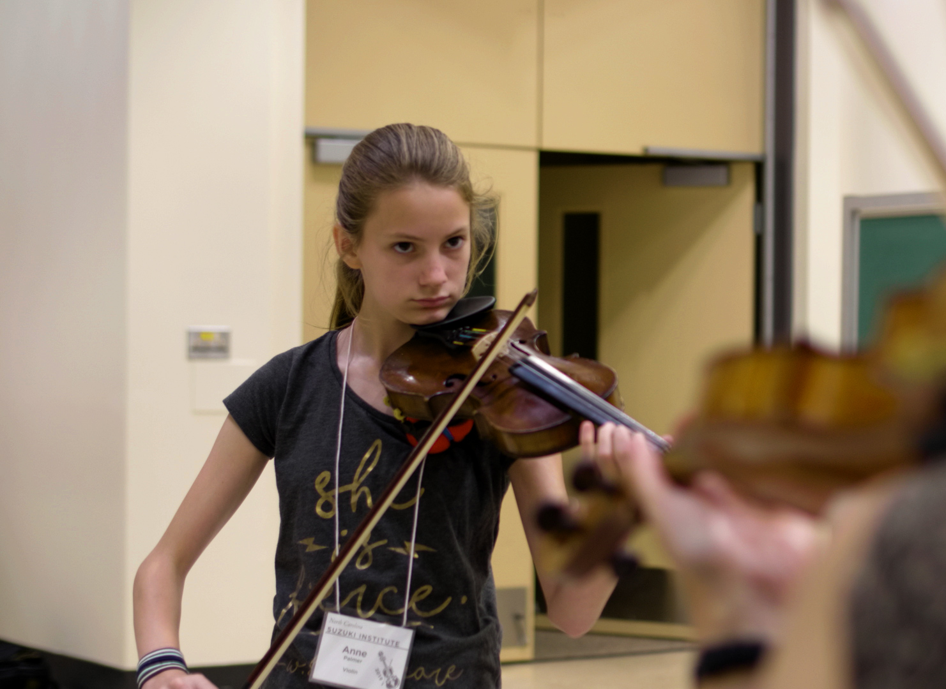
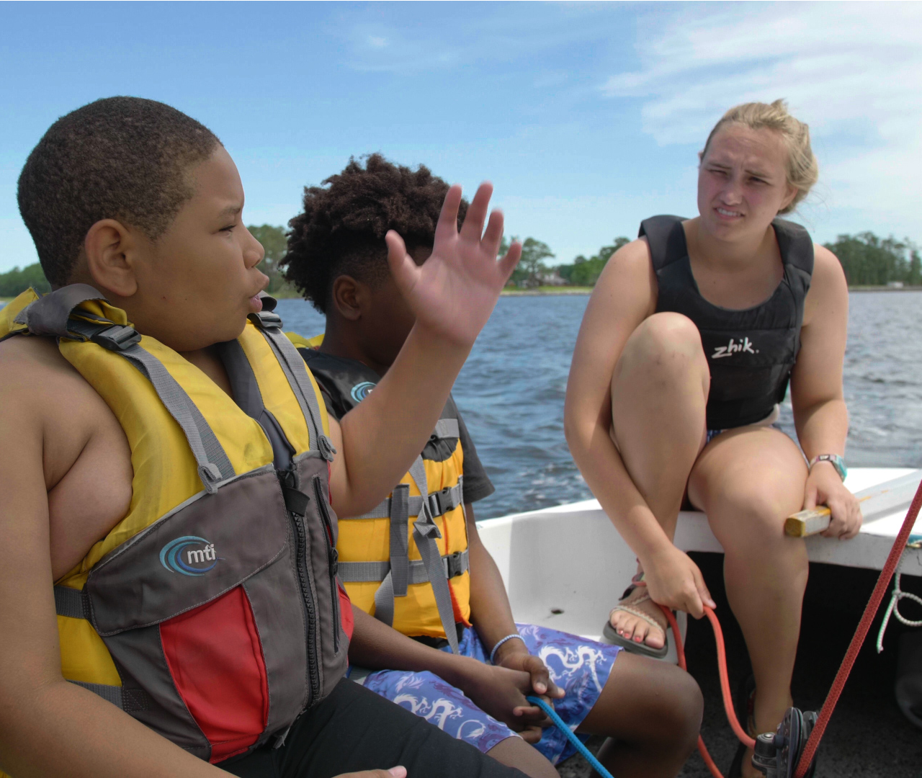
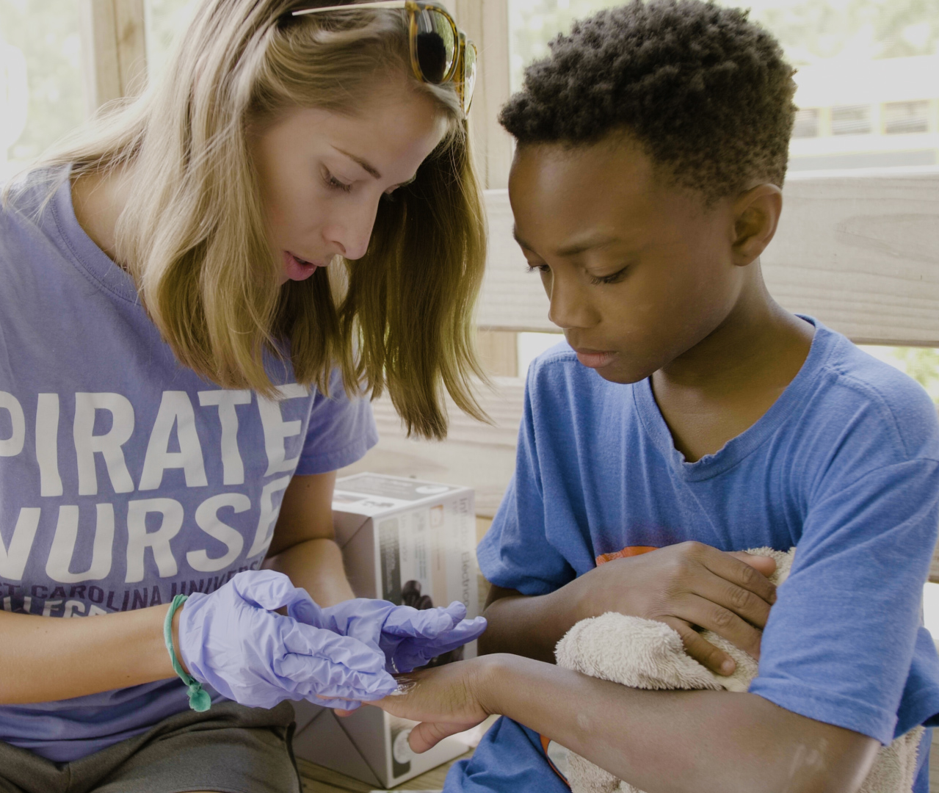
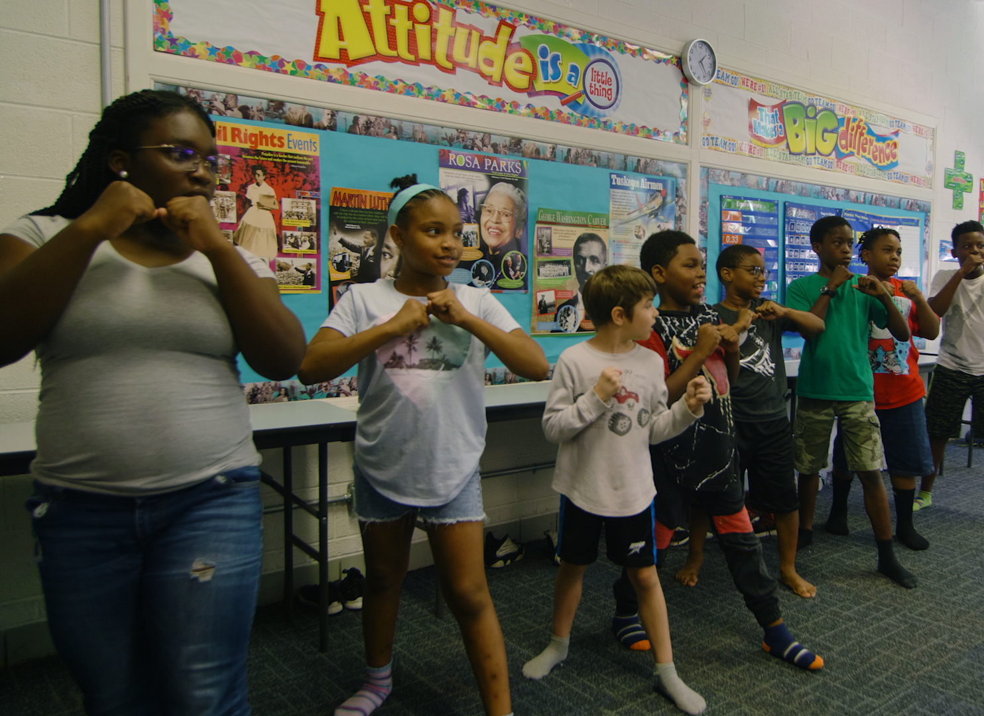
The Protection of Minors on Campus: Recognizing Abuse and Mandated Reporter Training
Youth Programs and Camps Office
East Carolina University
Notes:
Welcome to East Carolina University Youth Programs and Camps Training. This required training will give you an overview of your role and responsibilities regarding recognizing various forms of child abuse, your role as a mandated reporter, and information regarding preventing peer to peer/or child on child abuse within the camp or program setting. Please review this required training prior to your program start date and complete the Qualtrics link at the end of this training to allow your proof of completion to be documented.

Slide 2
Disclaimer
This training contains general information and guidelines. It is not intended to be a comprehensive summary or to address all possible training needs related to reporting. This training module should not be used as a substitute for additional training provided by individual Covered Programs or in place of guidance by administrators of Covered Programs on specific situations.

Slide 3
Disclaimer Continued
This training contains sensitive information related to child maltreatment. All content is intended to be educational while aiding program staff in identifying the signs of child maltreatment. This presentation is also meant to highlight staff’s duty to report different forms of abuse.
This training is self-paced and can be paused at any time. Resources are located at the end of this presentation.

Slide 4
Questions To Be Addressed in Presentation
Who are mandated reporters and what protections do they have?
What are the different forms of child abuse and neglect, and how are they identified?
When a child discloses abuse, what should I do with that information?
Where can I find resources related to this topic?
What is peer to peer abuse and what are the best practices in preventing it?

Slide 5
Mandated Reporters

Slide 6
Mandated Reporter Defined
In accordance with North Carolina State Law (G.S. 7B-301), any person or institution who reasonably suspects that a minor has been abused or neglected by a parent, guardian, custodian, or caretaker, has an absolute obligation to report that suspicion to the appropriate County Department of Social Services (County DSS) and Law Enforcement (LE), regardless of where the offense occurred.
ECU extends this guidance to encompass reporting all forms of child maltreatment, including peer-related abuse or inappropriate conduct involving a minor.

Slide 7
Examples of Mandated Reporters at the University
Faculty
Staff
Interns
Students
Temporary Employees
Junior Staff
Visiting Scholars/ Practitioners
Volunteers
University Affiliates (including employees/ volunteers working with a Third Party Program)
***Note: ECU employees should contact Bret Wilson, ECU Clery Coordinator, to schedule Clery Training as needed.

Slide 8
In accordance with state law, if you make a report about suspected child maltreatment in good faith, you will receive immunity from possible civil or criminal liability that may result from your report. In addition, no member of the University Community, including Covered Individuals, making a good faith report of suspected abuse or neglect will be retaliated against in the terms and conditions of employment, or within participation of educational programs or activities, as applicable, for adhering to the Protection of Minors Regulation and North Carolina law.
Protections for Mandated Reporters

Slide 9
Abuse and Neglect Defined

Slide 10
Defining Abuse
Abuse
According to the Department of Social Services, abuse is, “Any act or series of acts of commission or omission by a parent, guardian, or other caregiver that results in harm, potential for harm, or threat of harm to a child.”
Abuse
Physical
Emotional
Sexual
Peer to Peer
Neglect

Slide 11
Physical Abuse
Physical Indicators
Bruises at different stages of healing and in different shapes
Marks inconsistent with single-side fall or explanation for injury
Behavioral and Emotional Indicators
Excessive absences
Fear of parents or adults
Extreme aggression
Cognitive or intellectual impairments
Deficits in speech and language
Hyperactivity, impulsivity, and low frustration tolerance
Depression, low self-esteem, and suicidal thoughts or tendencies
Constant fatigue or inability to stay awake
Is easily agitated or defensive
Any nonaccidental serious injuries, pattern of injuries, or risk of serious injury to a child.
“Serious” is intentionally not defined, but may include:
Beating
Use of a weapon
Use of harmful restraints
Burning
Biting
Hitting
Shaking
Kicking

Slide 12
Emotional Abuse
Behavioral or Emotional Indicators
Low self-esteem or self-worth
Suicidal thoughts or ideations
Self-critical or overly anxious
Bullying or criticizing others
Guardian severely criticizes child in front of others, including:
Leaving a competition because of a child’s failure to perform
Depicting normal developmental activities harshly, including shameful name-calling
A pattern of verbal assaults or coercive measures against the child, which is destructive to the child’s sense of self-worth, including:
Sustained and repetitive criticism, shaming, or belittling
Setting unrealistic expectations
Blaming a child for things they have no control over
Terrorizing a child by destroying treasured belongings, relationships, or supports
Intentionally isolating a child
Rejecting or consistently favoring another child or sibling
Withholding love or affection

Slide 13
Sexual Abuse
Prevention Trainings in NC
Stewards of Children: Darkness to Light
Stop It Now
Signs
Physical signs are not common, but the following may be presented:
Bruising, bleeding, redness, etc. around the genitals
Sexually transmitted diseases
Chronic stomach pain, headaches or other ailments that can’t be explained medically
Grooming Signals
Grooming is the process of gaining the trust of a child or their family so that the perpetrator can gain access to a minor
Signs: gift-giving, doting, seeking one-on-one interactions, encouraging secrets, giving minors access to restricted things, testing physical boundaries
Physical acts perpetrated upon a child
Examples include: Sexual intercourse, fondling, oral-genital contact
Non-touching acts perpetrated upon a child
Examples include: taking obscene pictures or videos of minors, exhibitionism, holding sexually explicit conversations with or around minors
Notes:
In North Carolina, no minor under the age of 16 can legally consent to a sex act.
Depending on the circumstances, acts between minors may need to be reported and investigated.

Slide 14
Peer to Peer Abuse
Physical acts perpetrated upon a child by older, or more powerful children of the same age
Examples include- Sexual intercourse, fondling, oral-genital contact
Non-touching acts perpetrated upon a child by older, or more powerful children of the same age
Examples include- taking obscene pictures or videos of minors, exhibitionism, holding sexually explicit conversations with or around minors, sexting, experimentation
Notes:
In North Carolina, no minor under the age of 16 can legally consent to a sex act.
Depending on the circumstances, acts between minors may need to be reported and investigated.

Slide 15
Video on Preventing Peer to Peer Abuse

Slide 16
Assumption VS Reality
The Assumptions
Abusers are adults
Abusers are seasoned predators
We can “KEEP them OUT”
“It isn’t happening here” or “It can’t happen here”
The Realities
Child on Child abuse is just as common
Often starts with bullying
Doesn’t have to involve touch
Assume it is happening now
Notes:
To begin, we need to address some common assumptions and compare them to the reality around peer on peer abuse

Slide 17
What are the characteristics?
Same or different ages
Same or different sexes
Bullying
Coercive Behavior
Power imbalances
Notes:
A key difference is ‘it’s about power.’ It’s not just about sex acts. It’s often an extension of bullying.

Slide 18
3 Types of Power
Strength /Size
Social
Intellectual
Notes:
There are 3 types of power to consider. Strength and Size- I am bigger than you/strong than you- Social Power- those in higher power using it often as an extension of bullying. Were weaker, younger or less powerful youth are targeted. When children or youth are coerced it is a form of abuse. This could also include those in the vulnerable populations- such as LGBTQIA+- Children in that population are more likely to be bullied and abused by their peers, as well as adults. This is also the same for those who are considered as neuro diverse.

Slide 19
Assumption | Reality
Only “problem” youth abuse | According to Redwoods Insurance 60% incidents are child on child. Darkness2Light Foundation identifies 70% child on child.
We should only worry about “severe” cases | Cases of bullying grow and often lead to child-on-child abuse 74% involve similar ages (+/-1)
It’s rare and unlikely | Incidents are under-reported
Notes:
Let’s look at a few more assumptions…
D2L uses the statistic that 40% of CSA cases involve a minor who displays problematic sexual behavior. Redwoods Insurance group, who insures agencies like the YMCA, and others, stated that 60% incidents are child on child

Slide 20
1. Isolated 1-to-1 2. Physically isolated areas 3. In the presence of distracted adults/out of line of vision
How can it happen?
Notes:
How does this happen in youth serving organizations and beyond?

Slide 21
Assumption | Reality
Requires complete privacy | Even small lapses in supervision are dangerous
If staff or cameras, are present we are safe | Those that abuse are good at not being detected
I would see it and stop it | It can even happen in full view
You don’t catch people abusing children, you catch them breaking the rules and pushing boundaries.
Notes:
Staff can and do get distracted

Slide 22
Where and when does it happen?
Private Locations: Bathrooms, locker rooms, cabins
Obstructions: Playground Structures, closets, bus seats, underwater
Transition times: Transportation, sign-in/sign-out,
beginning/end of day
Notes:
Once we recognize abuse can and does happen, we need to start thinking about where are those places it can happen.
Think about when and where staff are positioned and where there might be holes. Look at this list and think about what might be missing. Whether you work within 4 walls, outside, etc…

Slide 23
Open mind and open eyes
Any obstruction creates “privacy” and potential
Towels, bus seats, furniture all create risk
Abuse happens on camera
Abuse happens with adults present

Slide 24
The good news is, we can create safe environments
Notes:
1.) understand the problem, 2.) create or learn policies and procedures, and 3.) FOLLOW the policies and procedures

Slide 25
Tips for Youth Program Planning
Staff programs/camps with proper ratios
Program in appropriate age groups
Rule of Three
Keep your program goers active
Pay attention to changes in behavior
Notes:
Spend time, “be with”

Slide 26
Preventing Risky Situations
Be aware of personality types and conflicts
Plan groups to avoid power imbalance
Follow supervision protocol
Do not allow alone time
Model healthy behaviors- no teasing,
favoritism,
or bad language
*You don’t catch people abusing, you catch them breaking
the rules and pushing boundaries
Notes:
SO many incidents begin with bullying. Be aware of bullying and watch for power imbalances.

Slide 27
Identify Red Flag Behaviors
Physical aggression or bullying
Sexualized language or behavior
Inappropriate touch
Youth sneaking off/seeking privacy
Notes:
When we see those red flag behaviors, we want to respond quickly and appropriately 1.) separate youth in conflict 2.) Address teasing before it becomes bullying 3.)

Slide 28
Code of Conduct
Review behavior policies with program goers
Training staff on proper boundaries
Document all incidents
Know when to report and who to report to
Notes:
When we see those red flag behaviors, we want to respond quickly and appropriately 1.) separate youth in conflict 2.) Address teasing before it becomes bullying 3.)
BJK to imbed two codes of conduct after slide 20.

Slide 29
Respond to Red Flag Behaviors
Separate youth in conflict
01
Address teasing before it becomes bullying
02
Actively follow-up with victims
03
Report concerns to supervisor
04

Slide 30
Additional Research
1 out of 10 children are sexually abused before their 18th birthday
90% of children who are sexually abused are abused by a family member or someone they know
35% of child victims are 11 years old or younger.
Youth are the victims of 66% of all sexual offenses reported to law enforcement.
Less than 2% of sexual abuse allegations are false

Slide 31
Defining Neglect
Neglect
Failing to provide for a child’s basic needs, including:
Physical
Ex: Improper clothing for weather conditions; lacking in food or other resources; abandonment
Ex: Lacking in adequate supervision (NC law does not define a minimum age in which children can be left alone, but fire code denotes age 8 as a minimum age)
Medical
Ex: Failure to provide adequate treatment
Educational
Emotional needs
Inappropriate discipline
Neglect
Physical
Emotional
Educational
Medical

Slide 32
Disclosures

Slide 33
React Responsibly
Listen calmly and openly
Don’t fill in the gaps or rush to “get to the bottom of it”
Do not “plant” ideas, but rather note exact language used by the child
Ask open-ended questions and be affirming by saying things like, “It’s okay to tell me more”
Believe the child – Let them know it is not their fault
Do not make promises you can’t keep (like this will never happen again)
Observe personal boundaries (especially hugs)

Slide 34
Understand How Disclosures By Children May Differ
Children may ask hypothetical questions or pretend the abuse has happened to someone else to gage your reaction
The minor may shut down or take back what they said because of fear or shame
Children may disclose parts of what has happened rather than all
Communication may be masked or nonspecific, for example, “Somebody keeps bothering me”

Slide 35
Written Disclosures
Disclosures may come in any form, including written, oral, and observed. Often, this occurs in application essays. The same criteria applies for reporting: if there is ‘reasonable suspicion’ leading you to believe that abuse occurred, you must report.
If a person over the age of 18 discloses historic abuse, staff are not required to report unless there is reason to believe that a minor may be at risk of abuse.

Slide 36
Reporting

Slide 37
Make a Report…
If you know that a minor is suffering abuse or neglect.
If you suspect that a minor is suffering abuse or neglect.
Regardless of where the alleged abuse is occurring.

Slide 38
Emergency Situations
In the event of an emergency or imminent danger, call 911 or the local law enforcement agency with jurisdiction. ECU Police can assist with on-campus crimes or referrals. The ECU Police non-emergency number is 252-328-6787.

Slide 39
Calling Department of Social Services
Reports or referrals must be made to the Department of Social Services in cases involving child maltreatment
A directory of all 100 county Department of Social Services can be found at Local DSS Directory
The reporting county for all reports involving minors in Greenville is Pitt County
Report to Pitt County DSS by calling 252-902-1110.
For after-hours incidents, call the Pitt County Sheriff’s Department at 252-830-4141 and ask for the social worker on call.

Slide 40
Helpful Information to Include in a Report
Name, age, address of victim
Ensure your registration requires a physical location address rather than a PO address
Name and address of parent/ guardian/ caretake
Information on other children in the home
Details about the abuse allegation

Slide 41
Internal Reporting
Programs can neither delay nor prohibit staff from reporting suspected child abuse or child neglect.
Supervisors can request that employees or volunteers notify leadership if that request will not cause interference with an investigation.
After reporting to external agencies, Covered Programs must submit a detailed report to the Coordinator of Youth Programs and Camps.
Internal reports do not relieve staff of their duty to report to DSS or law enforcement.

Slide 42
Additional Resources

Slide 43
Resources
Child Welfare Information Gateway
North Carolina Department of Social Services
Prevent Child Abuse North Carolina
US Center for Safe Sport

Slide 44
Questions?
For more information or questions, contact Omari Tait, Asst Director Youth Programs/Special Populations at taito21@ecu.edu or 252-328-4759

Slide 45
Sources Cited
The 5 Steps to Protecting Our Children™ - An Introductory Guide to Help Adults Protect Children From Sexual Abuse. (n.d.). Retrieved December 1, 2020, from https://www.d2l.org/education/5-steps/.
About DSS. (n.d.). Retrieved from https://www.ncdhhs.gov/divisions/dss.
Child Maltreatment Training: FREE Online: Prevent Child Abuse NC. (n.d.). Retrieved December 1, 2019, from https://www.preventchildabusenc.org/recognizing-responding-online-course/.
Redwoods Mandated Reporter Training- Retrieved April 2, 2022

Slide 46
Record of Completion
To record completion of this training, follow this link: https://ecu.az1.qualtrics.com/jfe/form/SV_4PalZoXs7NEYTA1

